Slide 1
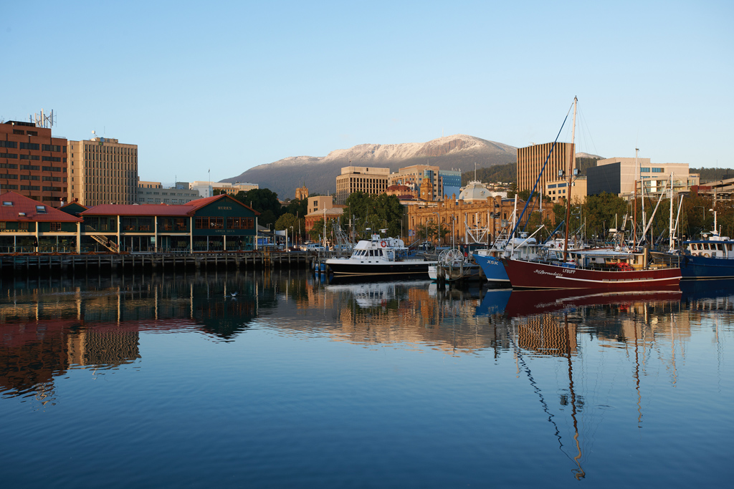
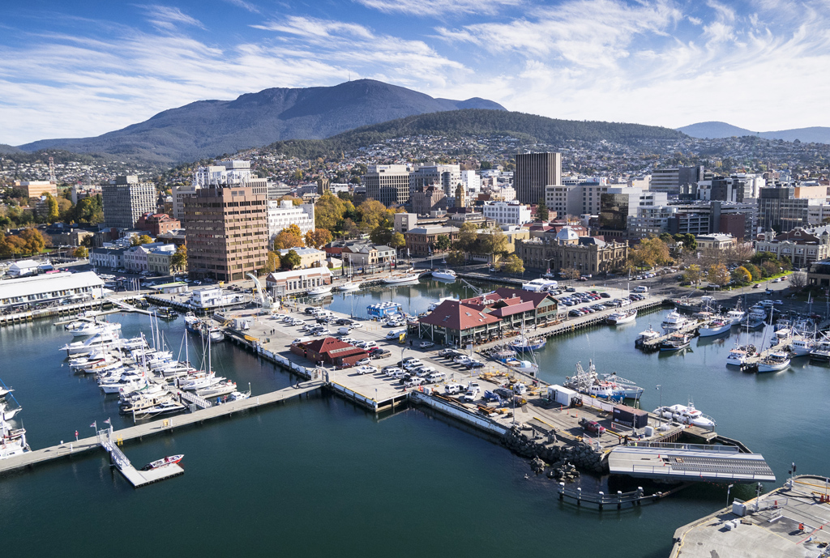
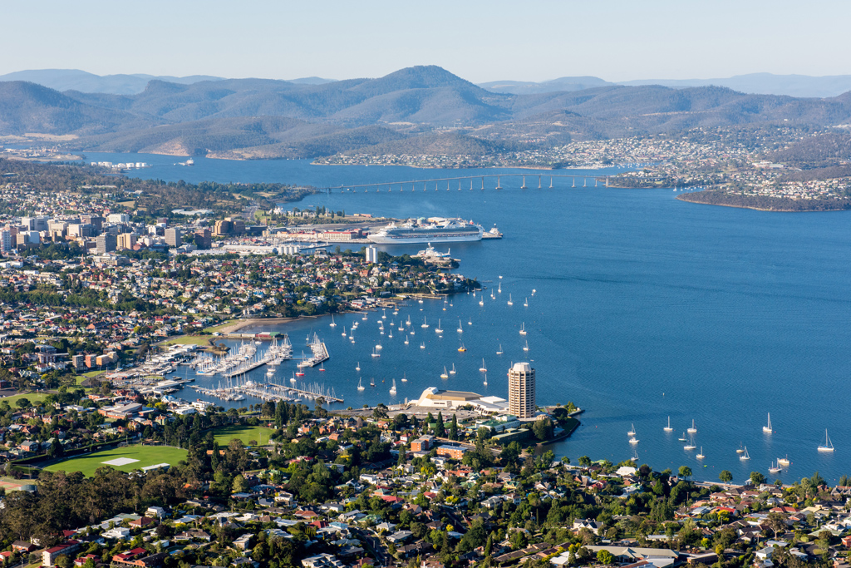
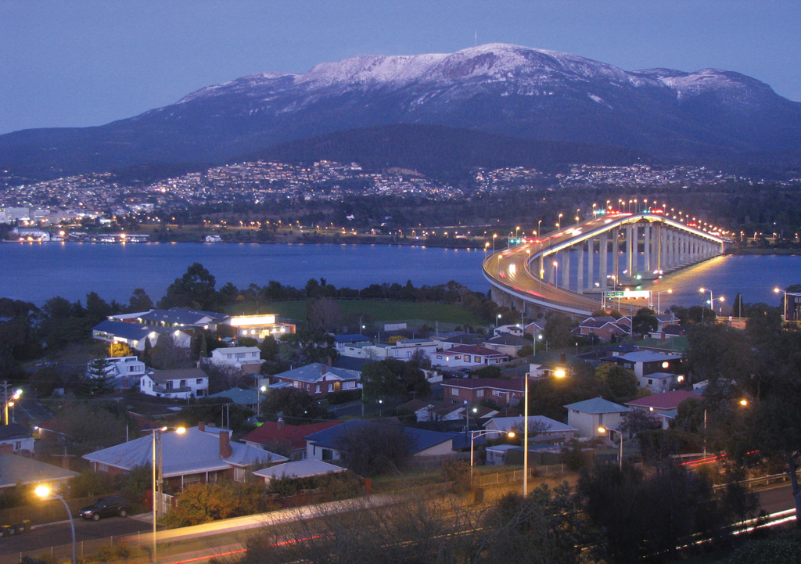
Hobart Tasmania – Sister City to Xi’An

Slide 2

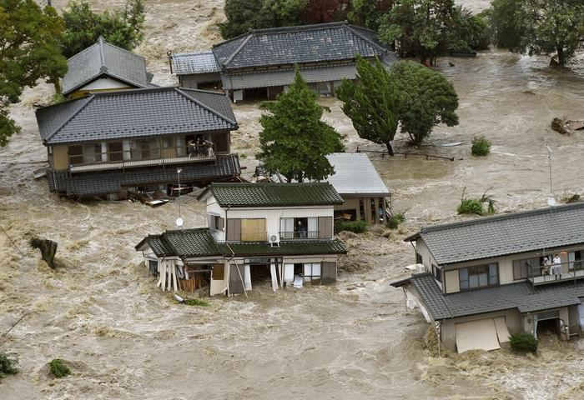
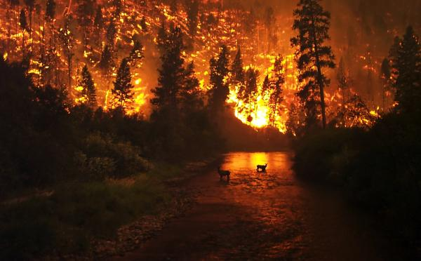
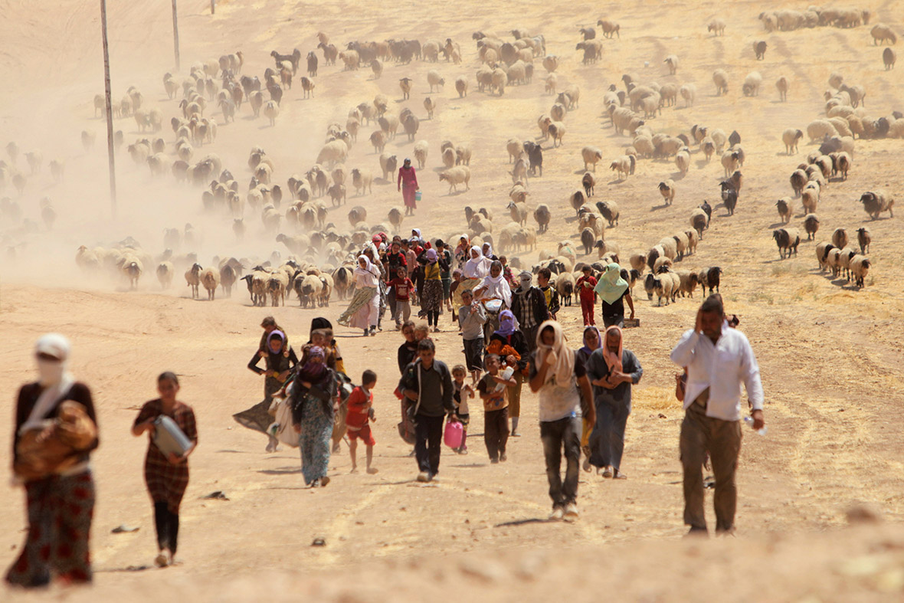

Impacts of CO₂ and other Emissions
Ocean Acidification: 1/3 of the CO₂ emitted by human activity has already been taken up by the ocean. As CO₂ dissolves in sea water , carbonic acid is formed.
Melting glaciers: cause sea level rise which further leads to more frequent coastal flooding and inundation.
Extreme weather: Droughts, floods, strong winds etc.
  An extreme heatwave in May 2015 killed 2500 people in India.
  Source: https://en.wikipedia.org/wiki/2015_Indian_heat_wave
  2.8 million people were recently evacuated with heavy floods in Japan
  A drought started the war in Syria
Source: http://www.nytimes.com/2015/03/03/science/earth/study-links-syria-conflict-to-drought-caused-by-climate-change.html?_r=0 http://news.nationalgeographic.com/news/2015/03/150302-syria-war-climate-change-drought/

Slide 3
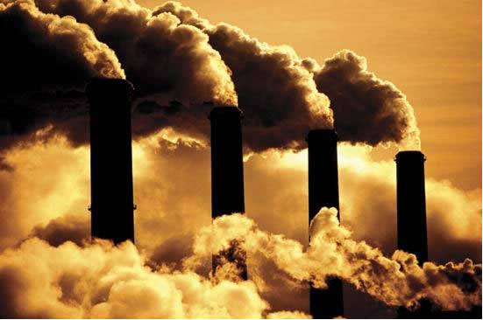
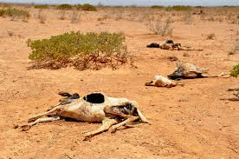
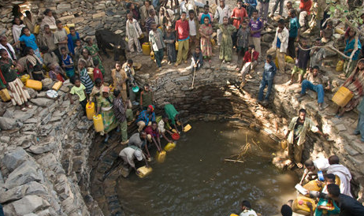
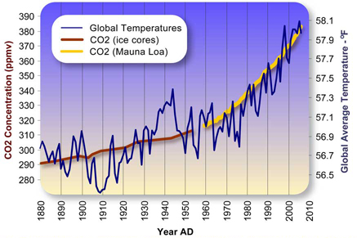


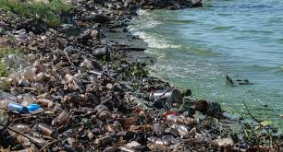


Global Problems are Interrelated

Slide 4

Global Cooperation
Spaceship earth is in trouble.
We must have better plan as the one we have is not working
it is essential we work together
and invent a more sustainable future!
危机
Wéijī
Image source: http://k12educationsystem.com/education-system-in-different-countries/

Slide 5
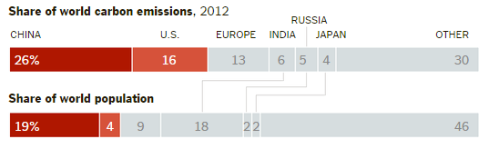
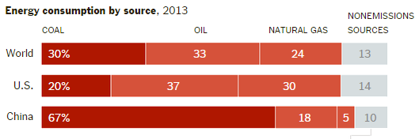
Carbon Dioxide in China Compared to the World
China is the world largest carbon dioxide emitter because:
It has the largest population in the world.
The Chinese economy relies heavily on coal.
Carbon dioxide is produced when coal is burned and is responsible for global warming and airborne particulates.
Source: BP Statistical Review of World Energy, June 2014

Slide 6
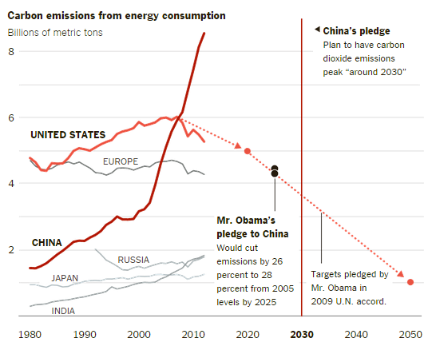
China’s Pledge to Reduce CO₂ Emissions
China’s president Xi Jinping, during a meeting with the President Obama on November 12th 2014 said: “China would brake the rapid rise in its carbon dioxide emissions, so that they peak around 2030 and then remain steady or begin to decline. And by then, (he promised), 20% of China’s energy will be renewable.”
Source: Energy Information Administration

Slide 7

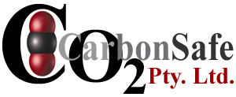

Green Cities
“There is a way to make our city streets as green as the Amazon Forest. Almost every aspect of the built environment from bridges to factories to tower blocks, and from roads to sea walls, could be turned into structures that soak up carbon dioxide – the main greenhouse gas behind global warming. All we need to do it is the change the way we make cement.” John Harrison
Pearce, F. (2002). "Green Foundations." New Scientist 175(2351): 39-40

Slide 8
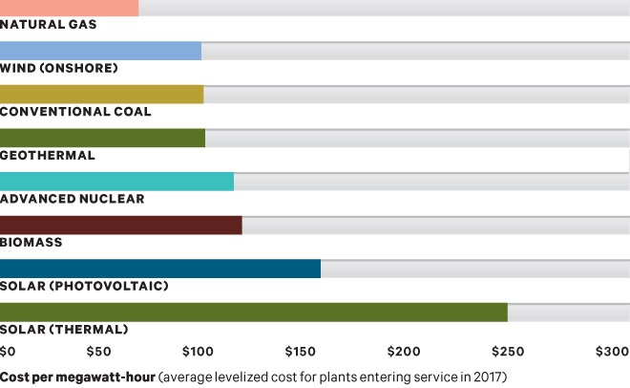
Energy’s all About Money
US$
Source:http://www.wired.com/2012/08/mf_naturalgas/. Chart design: Luke Shuman; Sources: BP, U.S. Department of Energy

Slide 9
..And Matching Supply & Demand
The power grid was originally designed around the concept of large, controllable electric generators.
Because grids generally have little or no storage capacity, the balance between electricity supply and demand must be maintained at all times with overlapping multi time interval planning to avoid blackouts or other cascading problems.
Intermittent renewables disrupt the conventional methods for planning daily operation of electrical grids.

Slide 10
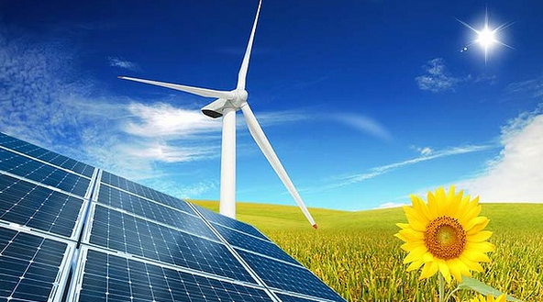
Renewables

Slide 11
Conventional Strategies to Compensate for Variability
The Law of Large Numbers
  Renewable energy actually becomes more predictable as the number of renewable generators connected to the grid increases thanks to the effect of geographic diversity and the Law of Large Numbers(1).
Prediction Algorithms
  Prediction is a growing science and is improving all the time.
Incentivizing Energy Production at the Right Time and Place
    A mix of renewable energy sources will tend to compliment each other. Continental winds peak at night, coastal winds during the day solar at various time during the day depending on orientation. With the right mix it is easier to load balance.
Notes:
The Law of Large Numbers is a probability theorem, which states that the aggregate result of a large number of uncertain processes becomes more predictable as the total number of processes increases.
The inspiration for this page was from Fares, Robert, Renewable energy Intermittency Explained: Challenges, Solutions and Opportunities. Scientific American Blog, March 11, 2015

Slide 12
Stylised Supply Issues
MW
Wasted Intermittent
Intermittant supply
Demand
Curve
Variable Supply
Utilised Intermittent
Base Load
Wasted energy is money lost. As an alternative to storage and applying the law of large numbers what about creating value such as fixing CO₂ as carbonate in the Syncarb process?
Time (hr)

Slide 13
New Strategies to Compensate for Variability
Develop technologies and processes that allow electricity consumption to be varied rapidly depending on a price signal.
  New small scale home technologies
    Will be made possible with cheap computer processors and communication over networks
    Examples: Fridges that do not come on at the same time as meals are being cooked. Heat pumps that co-operate with stoves etc.
    This will only happen if governments allow much more flexible energy pricing utilising computer networks for communication
  Doing work that can be done on an intermittent basis
    Pumping water or sewerage
    Pushing heavy electric trains up hill
  New industrial processes & technology
    As manufacturing and mineral processing is upgraded new ways will be found to add value to the supply chain when electricity is cheaper during periods of oversupply.
    Plant will be designed that can more variably be matched to the power supply.
    Smart networks, improved process control and plastics and metals printing will allow smaller scale plants on a localised basis to efficiently compete with larger plants with the advantage that they will have reduced freight costs and more rapidly be able to scale production to match demand and therefore be able to take advantage of cheaper energy prices.
Adding value with intermittent energy that would otherwise be in over supply & wasted.
Syncarb is an example of a process that can be scaled to match energy demand and supply

Slide 14
Moving Forward ?
Less energy, smarter and more service orientated economies.
  Dematerialisation is starting to happen in China
More renewables
  Slowing down because of lower natural gas prices
  Wider networks so the law of large numbers applies
  New technical paradigms
Energy with price signals. Demand, supply and supply sources matched by intelligent IT systems working in smart grids
  Prosumer energy (Producers who are also consumers)
More efficient storage
Use waste energy to create value

Slide 15
Renewable Energy Sources
Type of Energy | Description | Intermittent or Fixed | Elasticity or Flexibility | Net Emissions
Water | Hydro power captures the energy of flowing water in rivers and streams to generate electricity. | Fixed | Easily changed | None or low
Tidal & River Flow | Hydro kinetic power captures the energy of flowing water in tides and rivers without a significant fall to generate electricity. | Variable predictable | Not easily changed | None or low
Wind | Wind power harnesses the energy generated by the movement of air in the earth’s atmosphere to drive electricity-generating turbines. | Variable but predictable to some extent depending on location | Cannot generate more than the wind energy available but can generate less | None or low
Solar | Solar power harnesses the sun’s energy to produce electricity as well as solar heating and cooling. | Variable but predictable to some extent depending on location | Cannot generate more than the solar energy available but can generate less | None or low
Biomass | Biomass energy sources are used to generate electricity and provide direct heating | Variable over time and controllable | Cannot generate more than plant capacity or supply of biomass | Sequestration and emissions balanced.
Geothermal | Geothermal energy exploits naturally occurring high temperatures, located relatively close to the surface | Variable and controllable | Easily changed | None or low

Slide 16
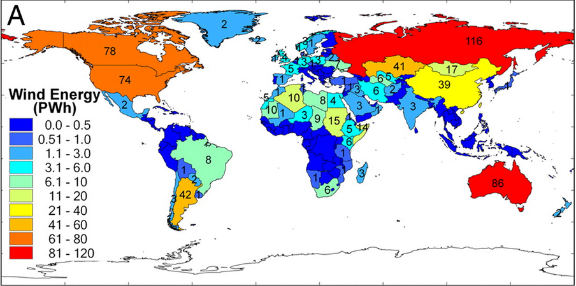
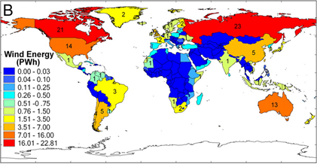
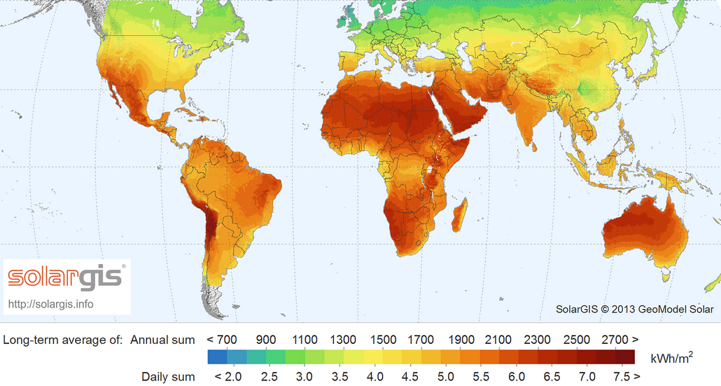
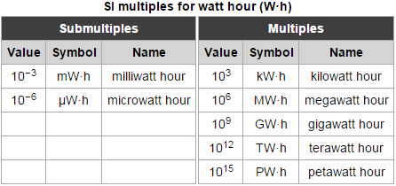
Globally Available Solar and Wind Energy
Annual wind energy onshore
Annual wind energy offshore
Most countries have either intensive wind or solar energy.
Some countries have both.
Solar and wind only accounts for 13% of world energy consumption.
Figure A & B: Global potential for wind-generated electricity, http://www.pnas.org/content/106/27/10933/F2.expansion.html
Global Horizontal Irradiation 2013

Slide 17
Changing Technical Paradigms
  “By enabling us to make productive use of particular raw materials, technology determines what constitutes a physical resource”
  Source: Pilzer, Paul Zane, Unlimited Wealth, The Theory and Practice of Economic Alchemy, Crown Publishers Inc. New York.1990
Technology defines what is or is not a resource
By inventing new technical paradigms and re-engineering energy and materials that are economic to produce we can change the underlying molecular flows that are damaging this planet.
We must produce and use energy and materials that have underlying molecular flows that reverse, mimic or at least do not disrupt natural flows

Slide 18
Changing the Technical Paradigm
$
Increase in demand/price ratio for new technical paradigms due to cultural change.
Supply
Greater Value/for impact (Sustainability) and economic growth
ECONOMICS
Equilibrium
Shift
We must rapidly move both the supply and demand curves for sustainability
Demand
Increase in supply/price ratio for more sustainable energy/products/technologies due to technical innovation.
#
A measure of the degree of sustainability of an industrial ecology is where the demand for more sustainable technologies is met by their supply.

Slide 19
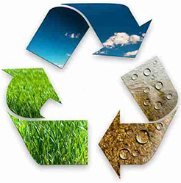
Changing the Techno-Process
Take => manipulate => make => use => waste
Driven substantially by fossil fuel energy with detrimental effects on earth systems.
Reduce
Re-use
Recycle
Innovate
Underlying moleconomic flows

Slide 20
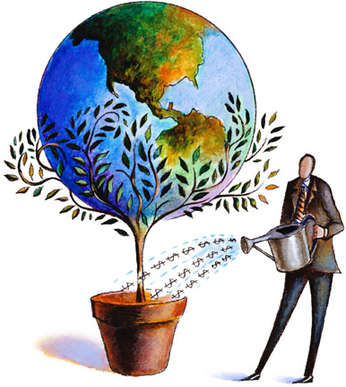
Technically Driven Change
Malcom Turnbull: “We have to recognise that the disruption that we see driven by technology, the volatility in change is our friend if we are agile and smart enough to take advantage of it.”
Alan Kay: “The best way to predict the future is to invent it.”
The Boston Consulting Group: “There are no old roads to new directions. ”
John Harrison: “New technology paradigms can solve many of the sustainability problems we have on spaceship earth. They are all connected.”
Al gore and David Blood: ”Sustainability investing is essential to creating long-term shareholder value.”

Slide 21
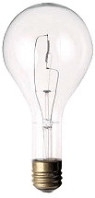


New Technical Paradigms >
Changed Techno-Process > Sustainability
Sand is now a Resource
Today almost everything that we don’t eat contains a silicon chip – cell phones, CD players, computers, hearing aids, TV’s and son and on.
Almost every car, appliance and toy has one or more silicon chips. The development of semiconductor physics is mirrored in the silicon devices made from sand.
Source: McWhan, Denis, "Sand and Silicon: Science that Changed the World" Oxford University Press, 2012
Light Globes - A Recent Paradigm Shift in Technology Reducing Energy Consumption
Light Globes in the last 10 years have evolved from consuming around 100 watts per 1700 lumens to less that 20 watts per 1700 lumens. As light globes account for around 30% of household energy this is as considerable saving.
Incandescent
Fluorescent
Led Light
100 watts
1700 lumens
25 watts
1700 lumens
<20 watts
1700 lumens

Slide 22
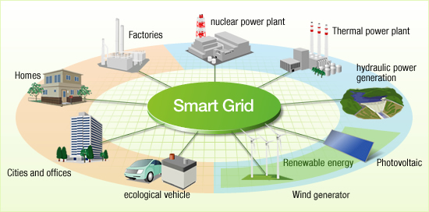
Smart Grids
Source: http://www.hitachi.com/environment/showcase/solution/energy/smartgrid.html

Slide 23
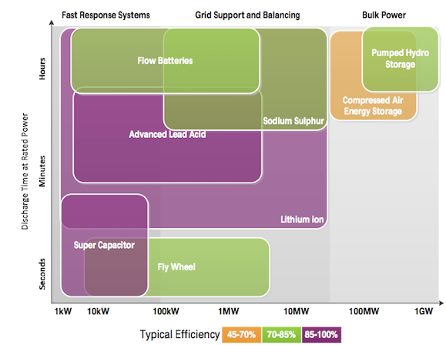
Storage
Store energy at times when supply exceeds demands to time-shift energy output to times of higher demand.
There are several approaches unfortunately however, they all have issues:
Occupy additional space or infrastructure
Large capital cost
Significant energy loss
Source: Renew economy, http://reneweconomy.com.au/2015/energy-storage-megashift-ahead-battery-costs-set-to-fall-60-by-2020-2020

Slide 24
Use Waste Energy to Create Value?
While most of people are focused on how to make energy cheaper, more flexible and storage more cost-efficient.
There is another way to utilise waste energy from oversupply or intermittent energy such as wind and solar that is normally turned off.
By re-designing and engineering manufacturing processes intermittent energy can be used when available to produce value.

Slide 25
Changing the Energy Paradigm on the Demand Side.
Energy adds value through processes. Because many current processes rely on a steady source of energy (baseload) 24/7 and are not able to adjust easily to fluctuations in supply, future production processes will have to be devised that can deliver value adding when energy is available.
Syncarb is introduced as a major breakthrough in flexible process as it solves global warming by adding significant value to CO₂ using cations from industrial and natural brines to produce value added carbonates, reactive magnesium oxide (rMgO), synthetic carbonate building materials, fresher water and potentially nitrogen fertilizer all of which are essential in global supply chains. Reactive magnesium oxide cements, which were invented by the author, are arguably the enabling technology for a world of future composites which will also result in significant recycling and process energy savings.
Given an increasing proportion of wind and solar the problem of baseload can be resolved not only by storage improvements but by the development of processes that can create value when alternative energy is available. Flexible production processes will accelerate the development of cleaner but intermittent energy from wind, solar and wave.

Slide 26
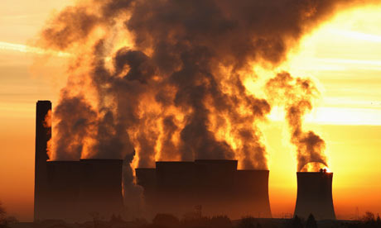
Syncarb

Slide 27
Syncarb
The Syncarb process is:
Simple
Scalable
Has low up front capital costs
No environmental impacts
Easily implemented
Industrially symbiotic and deployable over a wide geographical area
Produces saleable products including fresher water for insatiable markets.
An opportunity for power companies to use waste energy to solve their emissions problem in a flexible scalable process
The SynCarb process produces large quantities of carbonates including magnesium carbonates such as nesquehonite (MgCO₃.3H₂O) from waste magnesium cations (Mg++) such as found in oil process water, desalination waste water, bitterns and brines (step 1).
Nesquehonite is a commodity and can be sold directly, converted into other saleable magnesium compounds or calcined in our Tec-Kiln without releases (step 2) to make dead burned, caustic and reactive magnesia (rMgO) all of which are also commodities. rMgO is the key to bonding composite materials of the future made from a wide range of organic and inorganic wastes because it propagates polar bonding. It is also the basis of TecEco Cements. The CO₂ emissions from step 2 can be recycled back into step 1 resulting in the precipitation of more magnesium carbonates.
Acidification is prevented by using the balancing anion to produce acid, composites and aggregates and possibly fertilizer if we succeed in making ammonia in a process we are also working on.

Slide 28
Why Sea/Brine Water and CO₂?
Over 30 Gt carbon dioxide are released to the atmosphere every year, just as computers are now made from sand can we use it?
People think of CO₂ as a waste, John Harrison sees it as a resource!
We can make a profit if by changing the technical paradigms so CO₂ becomes a resource. We can use it as a raw material to make construction materials in a way that mimics nature.
The average concentration of magnesium ions in seawater is around 1.3 mg/L.
Seawater as a resource is virtually unlimited!
Waste brines such as oil process water, coal seam gas water, gas water and de-sal waste water contain high percentages of magnesium and can be used as an inputs in the Syncarb process to manufacture a range of products. Our first target will be building & construction products.
Because of the polar bonding propagated by magnesium, all manner of wastes both organic and inorganic can be incorporated.
The world of the future will be a world of composites made in this way.
We can create a new industrial ecology without outputs that are damaging to the global commons. Without CO₂ emissions, many brines and a wide range of what are currently considered wastes.

Slide 29
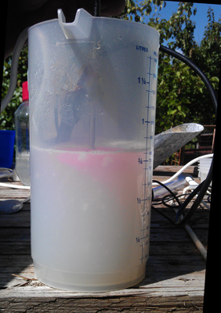
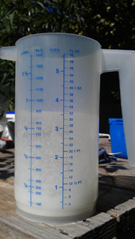
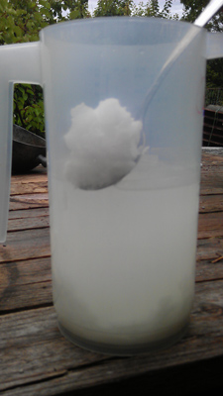
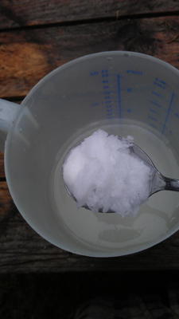
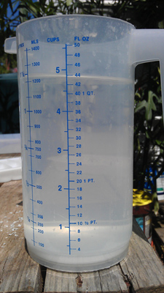
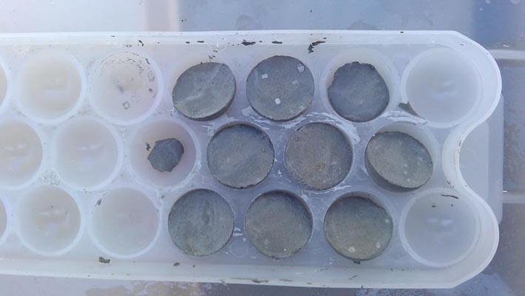
In the Laboratory
Precipitation from bitterns. The waste from salt manufacture and mainly MgCl₂
Colloidal at first
Microcrystallites
Massive
Close up
Aggregate made from precipitate and fly ash
Precipitate from seawater

Slide 30
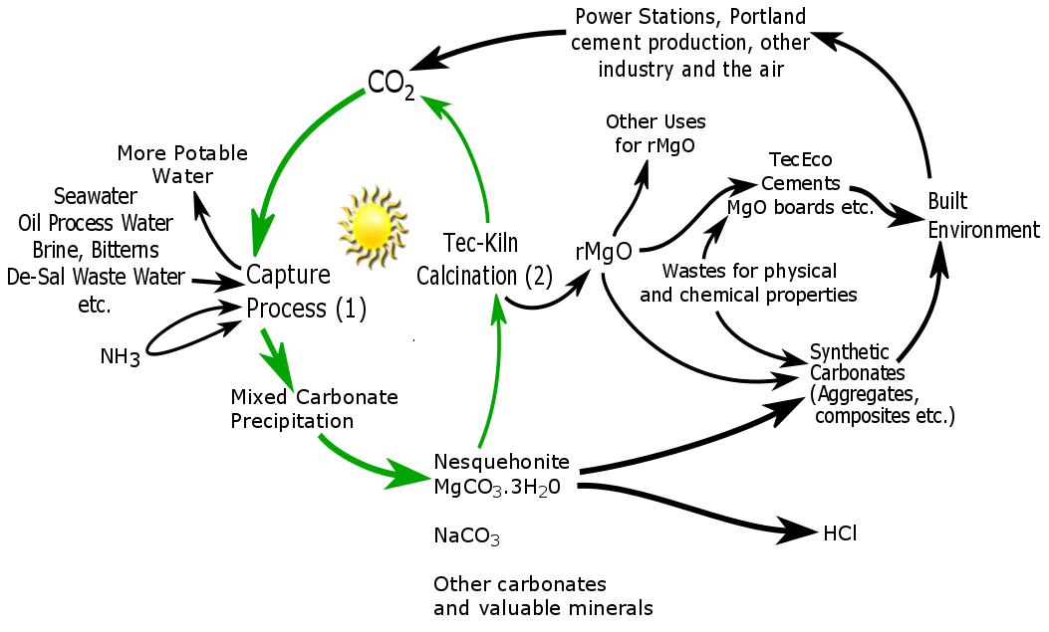
We Know We Can Separate Precipitates

Slide 31
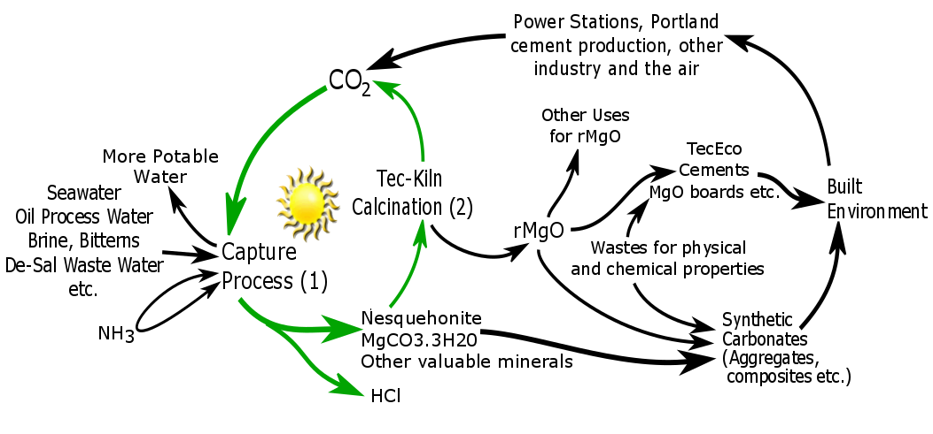
Syncarb as it is Now
If we could make ammonia without releases of CO₂ we could produce ammonium chloride which is a fertilizer
If we could separate the precipitates in the wet phase the process would be a lot more profitable

Slide 32
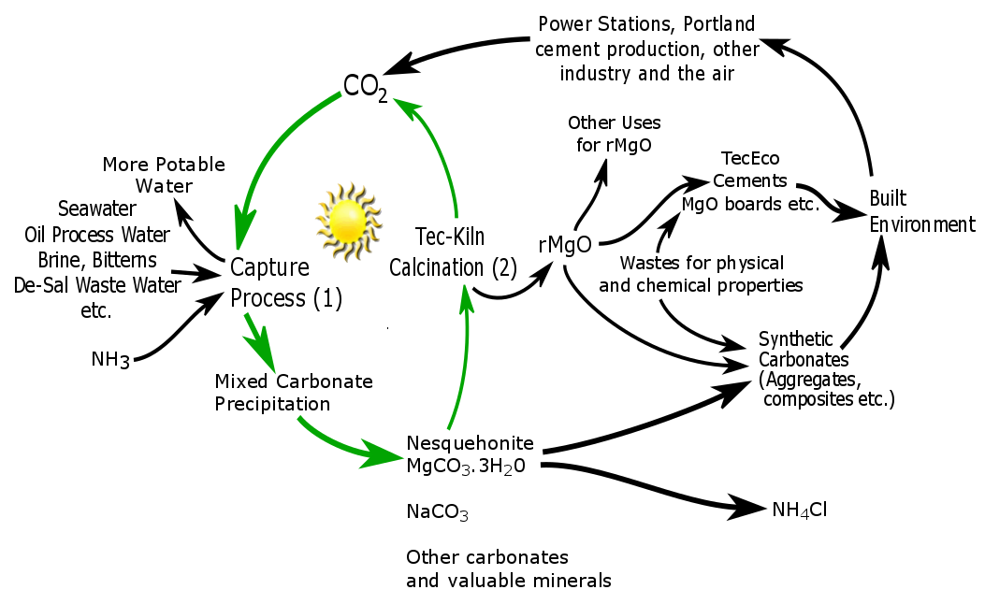
What next for Syncarb

Slide 33
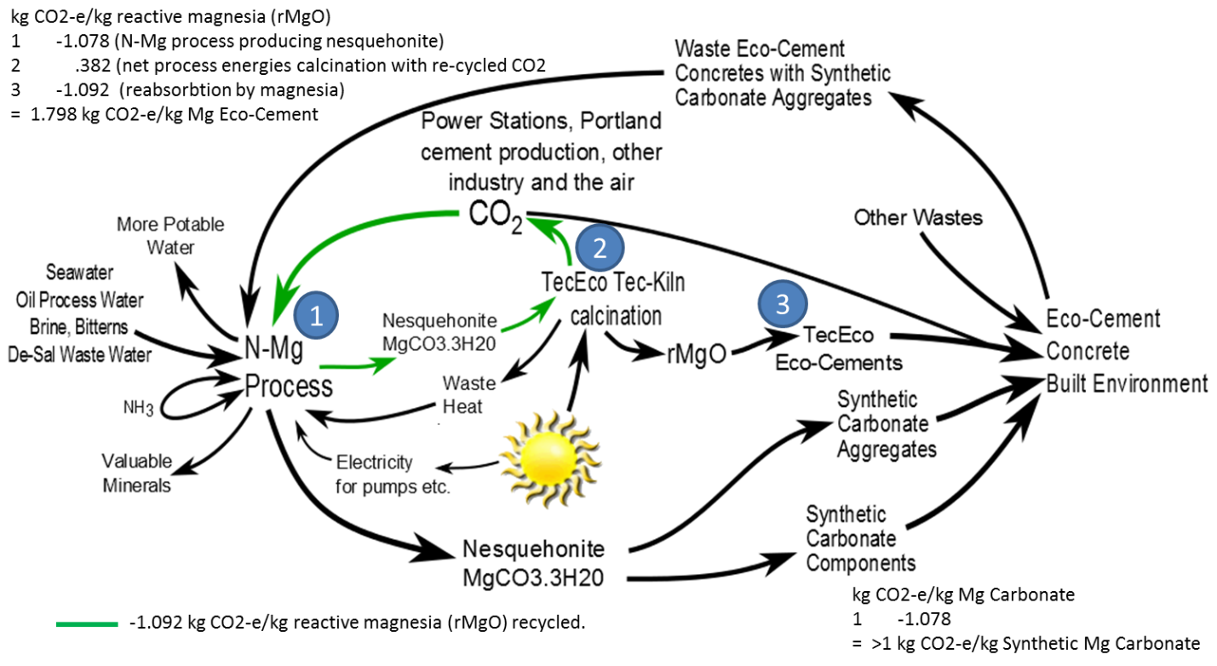
Syncarb Gaia Engineering Thermodynamics

Slide 34
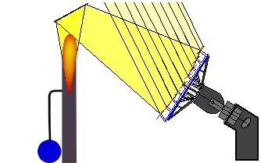
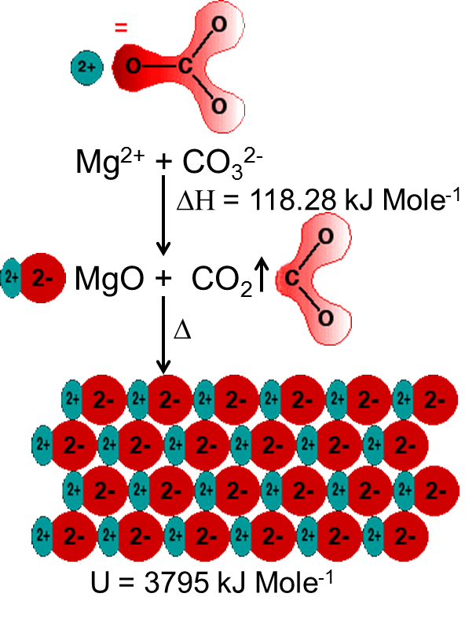
The Tec-Kiln
An obvious future requirement will be to make cements without releases so TecEco are developing a top secret kiln for low temperature calcination of alkali metal carbonates and the pyro processing and simultaneous grinding of other minerals such as clays.
The TecEco Tec-Kiln has no releases and is an essential part of TecEco's plan to sequester massive amounts of CO₂ as man made carbonate in the built environment .
The TecEco Tec-Kiln has the following features:
Operates in a closed system and therefore does not release CO₂ or other volatiles substances to the atmosphere.
  The CO₂ produced will be recycled in the N-Mg process.
Can be powered by various potentially cheaper non fossil sources of energy such as intermittent solar or wind energy and is energy smart.
Grinds and calcines at the same time thereby running 25% to 30% more efficiently.
Produces more precisely definable product. (Secret as disclosure would give away the design)

Slide 35
Separation of Syncarb Products & the Properties of Water
Water is a polar covalent molecule, it has a slight positive and slight negative charge on opposite ends. Two hydrogens are attached to oxygen and the molecule forms a 109.5º bend.
Because water is a bent, partially polar molecule it bonds to other polar molecules, has statistical structure, cohesion and surface tension.
Polar bonding strength is affected by both Kaotrophes and cosmotrophes as well as dissolved gases.
Water disassociates into H₃O+ and OH- depending on ions present in solution and through a mostly proton wrenching process solvates (dissolves) minerals.
The success of Syncarb as a process depends on our understanding of the unique properties of water and how we can manipulate them.

Slide 36
Syncarb - Adding Values to Wastes
The Syncarb process is a new game changing mineral sequestration process.
Instead of using minerals, the raw materials are CO₂ and waste brine which contains large amount of Mg²⁺, Ca²⁺ and Na⁺ ions.
CO₂ adds significant value to brines compared to evaporative precipitation.
Compared with normal mineral carbonation:
Low input costs – raw materials
Olivine: $65-145/ton, Serpentine (chrysotile): ~$1500/ton, Wollastonite: $120-140/ton
Waste brine water is a pollutant and people will pay us to use it?
Low capital cost – transport
Transportation of minerals from mining site to operation sites consumes labor and energy.
Syncarb inputs are transported in pipes by pumping.

Slide 37
Syncarb - Adding Values to Wastes
All the first stage outputs from Syncarb are commodities such as calcium and magnesium carbonates, sodium bicarbonates (?), gypsum etc.
Secondary products include reactive magnesia (rMgO), Tec and Eco - Cements already widely used around the world in the building and construction industries.
Water produced by the process can be used for irrigation, gardening, showering, washing etc. With minor secondary processing for drinking water.
Ammonium chloride hopefully produced by process is mainly used as a nitrogen source in fertilizers. Other than that, it also can be used as a flux for metal coating, an expectorant for cough medicine, a food additive for food industry and so on.
The Syncarb process utilizes a variety of wastes from heavy industries and converts them into profitable and widely used materials for the construction and that are the start of the supply chain in other industries.
Syncarb reverses the waste output of industrial ecologies that damage the environment by adding value to them as new inputs in the supply chain

Slide 38
Syncarb - Adding Values to Wastes
The production of reactive magnesia in the Syncarb process enables TecEco cement technologies I invented years ago to become viable.
Tec and Eco Cements are ideal for bonding organic and inorganic wastes to make composites and are ideal for immobilizing and utilizing toxic and hazardous wastes such as fly and bottom ash iron slags, red mud etc.
The wastes incorporated which can either be organic or inorganic further enhance the physical and chemical properties of the composite products produced which initially will mostly be for the building and construction industries.

Slide 39
Syncarb Summary
Inputs
Outputs
CO2
Bitterns
Waste brines
Oil process water
Gas process water
Coal water
Coal seam gas water
De-sal waste water
etc.
NH3
Mg Carbonates => TecEco cements
Ca Carbonates
Na Carbonates
Na Bicarbonates
Gypsum
Other salts
HCl or NH4Cl
Fresher water => potable water

Slide 40
TecEco-Cements
Tec-Cements (5-20% MgO, 80-95% OPC)
contain more Portland cement than reactive magnesia. Reactive magnesia hydrates in the same rate order as Portland cement forming Brucite which uses up excess water reducing the voids:paste ratio, increasing density and possibly raising the short term pH.
Reactions with pozzolans are more affective. After much of the Portlandite has been consumed Brucite tends to control the long term pH which is lower and due to it’s low solubility, mobility and reactivity results in greater durability.
Other benefits include improvements in density, strength and rheology, reduced permeability and shrinkage and the use of a wider range of aggregates many of which are potentially wastes without reaction problems.
Eco-Cements
Eco-Cements are blends of one or more hydraulic cements and relatively high proportions of reactive magnesia with or without pozzolans and supplementary cementitious additions. They will only carbonate in gas permeable substrates forming strong fibrous minerals such as lansfordite and nesquehonite. Water vapour and CO₂ must be available for carbonation to ensue.
Eco-Cements can be used in a wide range of products from foamed concretes to bricks, blocks and pavers, mortars renders, grouts and pervious concretes such as our own permeacocrete. Somewhere in the vicinity of the Pareto proportion (80%) of conventional concretes could be replaced by Eco-Cement.

Slide 41

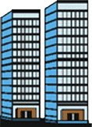


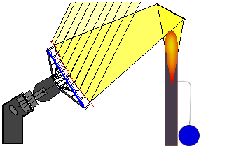
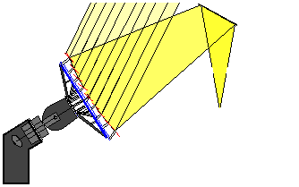
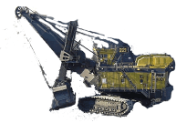


Gaia Engineering
Inputs:
Atmospheric or industrial CO₂,
brines (e.g. de-sal and process waste water, other wastes
Outputs:
Carbonate building materials, NH₄Cl, fresher water.
Gaia Engineering is an industrial ecology that delivers profitable outcomes whilst reversing underlying undesirable moleconomic flows from other less sustainable carbon emitting processes.
Carbonate building components
CO₂
Syncarb
Solar or solar derived energy
CO₂
CO₂
Tec-Kiln
CO₂
Eco-Cement
rMgO
MgCO₃.3H₂O
Extraction Process
Coal
1.29 gm/l Mg
.412 gm/l Ca
Carbon or carbon compounds
Magnesium compounds
Fossil fuels
Oil
www.tececo.com www.gaiaengineering.com

Slide 42
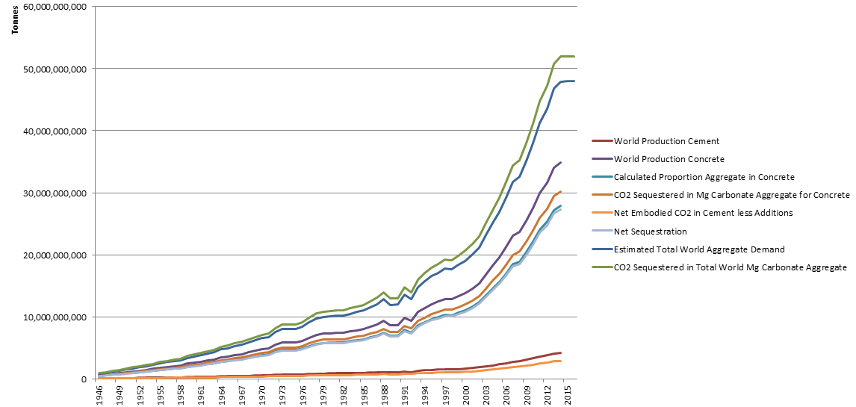
Syncarb Sequestration
Syncarb implemented widely is the solution to global warming the world needs as it profitably sells synthetic carbonate into huge insatiable markets.
Current Global Emissions in this Range
Global demand for construction aggregates exceeds 48 billion tonne.
Source: http://www.concreteconstruction.net/aggregates/global-demand-for-construction-aggregates-to-exceed-48-billion-metric-tons-in-2015.aspx
Other Statistics: U.S. Geological Survey, Mineral Commodity Summaries

Slide 43
Syncarb Sequestration if only output is Aggregate for Concrete - Assumptions
Assumptions
Percentage by weight of cement in concrete | 12.00%
Percentage by weight of MgO in Tec-Cement | 9%
Percentage by weight Ca(OH)2 in cement | 29%
% of Ca(OH)2 in concrete that carbonates | 10.00%
Proportion cement that is flyash and/or GBFS | 20%
1 tonne Portland Cement | 0.867 | Tonnes CO2
Proportion concrete that is aggregate | 80.0%
CO2 captured in 1 tonne aggregate | 1.084 | Tonnes CO2
Net CO2 sequestration 1 tonne rMgO (N-Mg route, 1 complete recycle) | 0.000 | Tonnes CO2
CO2 captured hydration and carbonation of 1 tonne CaO (in PC) | 0.000 | Tonnes CO2
Source global production statistics : USGS web site.
Note that there will be a trade off between aggregate quality and amount of other waste used in the formulation such as fly ash and mine tailings both of which unfairly are rated as having lower embodied energies and emissions

Slide 44
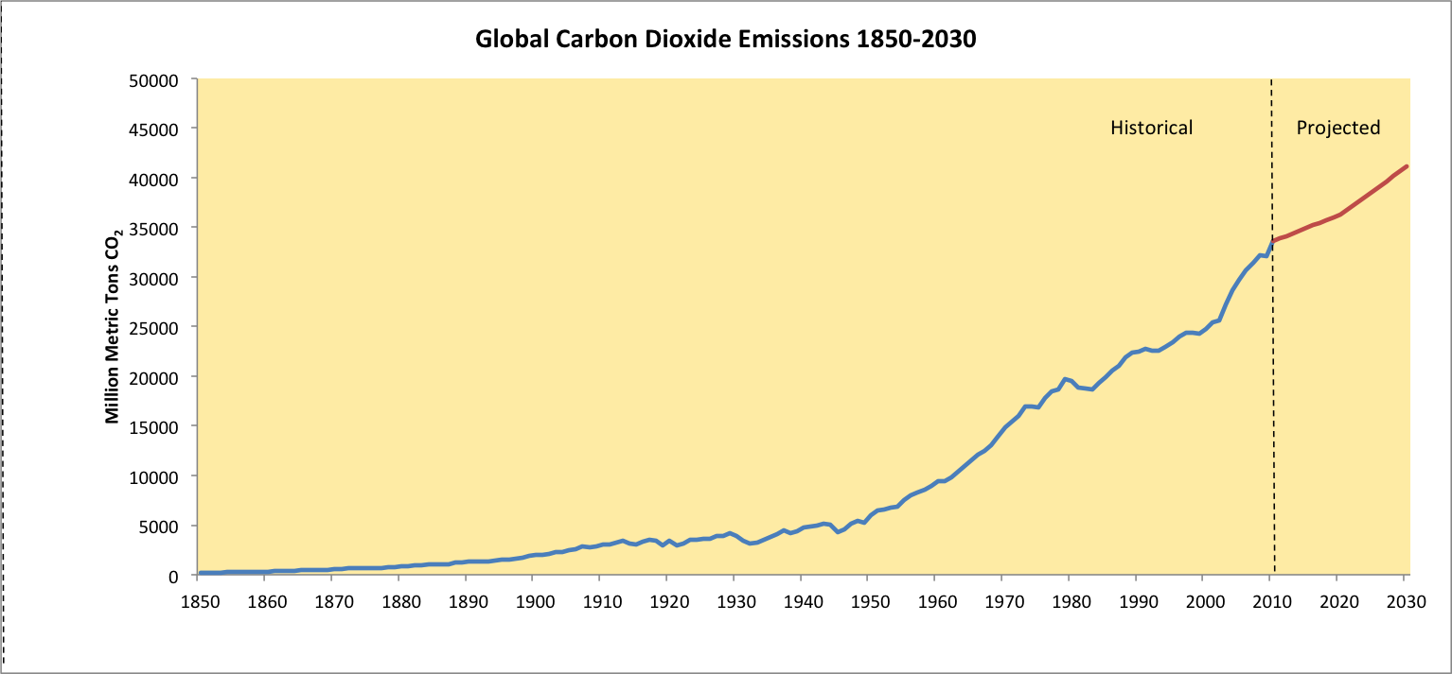
Global Emissions
Source: http://www.c2es.org/docUploads/global-co2-historical-3.png

Slide 45
Conclusions
Polluting the global commons must stop altogether. We must stop throwing energy, matter and dangerous molecules away. There is no such place.
Interactions with the biosphere-geosphere must be sustainable
The technosphere must be contained within itself with 100% recycling.
Recycling everything including CO₂ is technically possible.
As energy drives the supply and waste chains (the techno-process), with efficient recycling we can reduce the embodied energy & emissions of materials.
There is a huge potential resource in renewable energy especially of unused wind and solar given their significant flux.
Flexible value adding processes compliment the development of renewable energy and materials by providing a use that may otherwise be wasted if in over supply because of prevailing conditions.
Syncarb is flexible process and a game changer in relation to the above because it reverses much of the supply and waste chains in the techno-process.
Solving global warming is only possible economically. It will not happen because it is necessary or right.

Slide 46
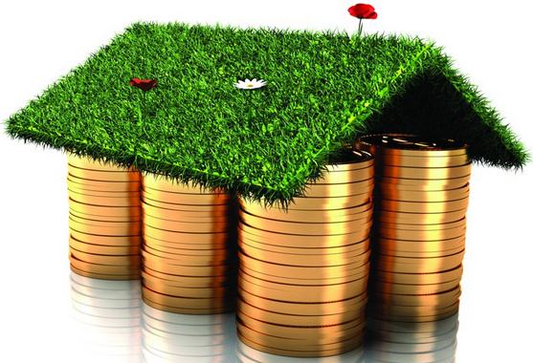
I have spent a lifetime inventing new technology paradigms.
Please help me turn my ideas for a better, more profitable
and sustainable future into invoices before it is too late.
Aubrey John W Harrison
Carbonsafe Pty Ltd
497 Main Road
Glenorchy
Tasmania 7010 Australia
Ph/Fax: +61 (0)3 62492352
Mob: +61 (0)413993911
Email: john.Harrison@carbonsafe.com
谢谢你听
Xièxiè nǐ tīng
谢谢聆听
Xiexie Ling ting

